Slide 1
Capital Bikeshare: Metro DC’s bikeshare service
Melinda Wiley, Caylon Thomas, Kwasi Yeboah-afihene, and Sarah Christensen

Slide 2
# Presentation Guidelines
You are free to structure your presentations to your liking, but students tend to have success with the following format.
* Title Slide
* Include the name of the Project and Group Members
* Motivation & Summary Slide
* Define the core message or hypothesis of your project.
* Describe the questions you asked, and _why_ you asked them
* Describe whether you were able to answer these questions to your satisfaction, and briefly summarize your findings
* Questions & Data
* Elaborate on the questions you asked, describing what kinds of data you needed to answer them, and where you found it
* Data Cleanup & Exploration
* Describe the exploration and cleanup process
* Discuss insights you had while exploring the data that you didn't anticipate
* Discuss any problems that arose after exploring the data, and how you resolved them
* Present and discuss interesting figures developed during exploration, ideally with the help of Jupyter Notebook
* Data Analysis
* Discuss the steps you took to analyze the data and answer each question you asked in your proposal
* Present and discuss interesting figures developed during analysis, ideally with the help of Jupyter Notebook
* Discussion
* Discuss your findings. Did you find what you expected to find? If not, why not? What inferences or general conclusions can you draw from your analysis?
* Post Mortem
* Discuss any difficulties that arose, and how you dealt with them
* Discuss any additional questions that came up, but which you didn't have time to answer: What would you research next, if you had two more weeks?
* Questions
* Open-floor Q&A with the audience
- - -
## Copyright
Coding Boot Camp © 2018. All Rights Reserved.

Slide 3
# Presentation Requirements
The presentation requirements for Project 1 are as follows.
Your presentation must:
* [ ] Be at least 8-10 min. long
* [ ] Describe the core message or hypothesis for your project.
* [ ] Describe the questions you and your group found interesting, and what motivated you to answer them
* [ ] Summarize where and how you found the data you used to answer these questions
* [ ] Describe the data exploration and cleanup process (accompanied by your Jupyter Notebook)
* [ ] Describe the analysis process (accompanied by your Jupyter Notebook)
* [ ] Summarize your conclusions. This should include a numerical summary (i.e., what data did your analysis yield), as well as visualizations of that summary (plots of the final analysis data)
* [ ] Discuss the implications of your findings. This is where you get to have an open-ended discussion about what your findings "mean".
* [ ] Tell a good story! Storytelling through data analysis is no different than in literature. Find your narrative and use your analysis and visualization skills to highlight conflict and resolution in your data.
- - -
## Copyright
Data Boot Camp © 2018. All Rights Reserved.

Slide 4
# Technical Requirements
The technical requirements for Project 1 are as follows.
* [ ] Use Pandas to clean and format your data set(s)
* [ ] Create a Jupyter Notebook describing the **data exploration and cleanup** process
* [ ] Create a Jupyter Notebook illustrating the **final data analysis**
* [ ] Use Matplotlib to create a total of 6-8 visualizations of your data (ideally, at least 2 per "question" you ask of your data)
* [ ] Save PNG images of your visualizations to distribute to the class and instructional team, and for inclusion in your presentation
* [ ] Optionally, use at least one API, if you can find an API with data pertinent to your primary research questions
* [ ] Create a write-up summarizing your major findings. This should include a heading for each "question" you asked of your data, and under each heading, a short description of what you found and any relevant plots.
- - -
### Copyright
Coding Boot Camp © 2017. All Rights Reserved.

Slide 5
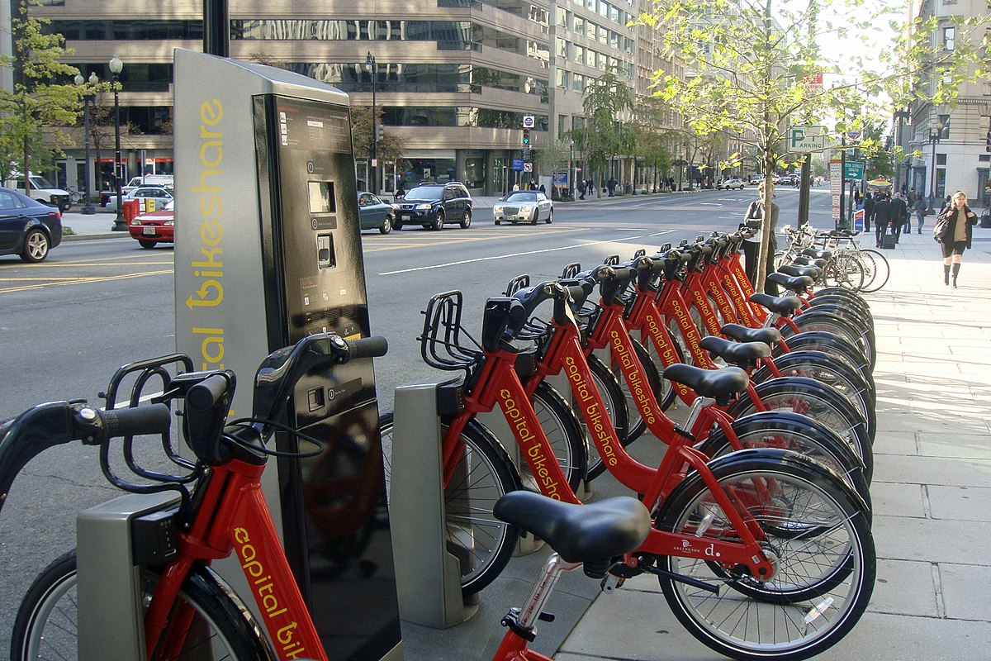
Motivation & Summary - Mindy
Motivation & Summary Slide
Define the core message or hypothesis of your project. Capital Bike share – core message and hypothesis
We completed an analysis of Capital Bike share which is located here in DC
Our core message – to see how Capital Bike share has grown over the last 9 years – from 2010 - 2018
Describe the questions you asked, and why you asked them
Member type – Casual & Member; usage over time
Bike dock stations/ terminal build out - Additional and removal of docks between 2010-2018
Are there peaks times (Years, Months, Times during the day)?
Which terminals are used the most vs not used very often?
This Photo by Unknown Author is licensed under CC BY-SA

Slide 6
Peak Times and Terminal usages - Mindy
* Questions & Data
* Elaborate on the questions you asked, describing what kinds of data you needed to answer them, and where you found it
* Data Cleanup & Exploration
* Describe the exploration and cleanup process
* Discuss insights you had while exploring the data that you didn't anticipate
* Discuss any problems that arose after exploring the data, and how you resolved them
* Present and discuss interesting figures developed during exploration, ideally with the help of Jupyter Notebook
* Data Analysis
* Discuss the steps you took to analyze the data and answer each question you asked in your proposal
* Present and discuss interesting figures developed during analysis, ideally with the help of Jupyter Notebook
* Discussion
* Discuss your findings. Did you find what you expected to find? If not, why not? What inferences or general conclusions can you draw from your analysis?

Slide 7
Mindy

Slide 8
Member type - Kwasi
Questions
Which member type has the highest level of usage on the average per year?
Which member type dominates the biker population of capital bike share
Data source: Capital Bike Share data from 2010 – 2018
Random Sample Size: 40000 per year except 2018, which had a sample size of 30000 records
Analysis
Performed a nested groupby: [Year, Member type] and summarized the data by finding the mean duration for the first question.
Performed a nested groupby: [Year, Member type] and summarized the data by counting the duration variable.
Drew a line graph for both
Related code snippets:
Q 1
newgroup = bike_file_one_df.groupby(['Year', 'Member type']).mean()['Duration'].unstack().plot()
newgroup.set_ylabel("Mean Usage Per Second")
newgroup.set_xlabel("Year")
plt.savefig("Pie_Fig_19.png")
plt.show()
Q2
newgroup = bike_file_one_df.groupby(['Year', 'Member type']).count()['Duration'].unstack().plot()
newgroup.set_ylabel("Count of Member Type")
newgroup.set_xlabel("Year")
plt.savefig("Pie_Fig_20.png")
plt.show()
*

Slide 9
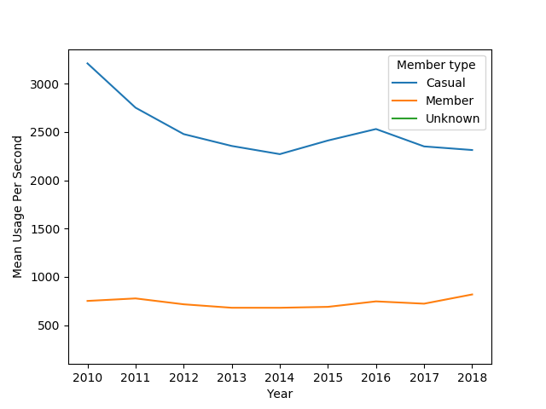
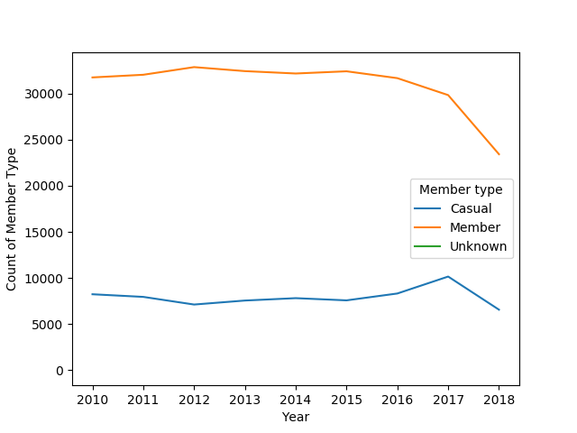
Member Type - Kwasi ‘Findings and Conclution’
Kwasi
Casual users on the average use the bikes for a longer period of time than Members
The usage level of casual users is trending down from 2010 to 2018
The members are about 3/4 of the biker population of Capital Bike Share
The casual users are about 1/3 of the biker population
Note: Only 3 quarters of data was reported in 2018, Hence 3000 records were randomly selected. [10000 samples were randomly selected per quarter]

Slide 10
Sarah
* Questions & Data
* Elaborate on the questions you asked, describing what kinds of data you needed to answer them, and where you found it
* Data Cleanup & Exploration
* Describe the exploration and cleanup process
* Discuss insights you had while exploring the data that you didn't anticipate
* Discuss any problems that arose after exploring the data, and how you resolved them
* Present and discuss interesting figures developed during exploration, ideally with the help of Jupyter Notebook
* Data Analysis
* Discuss the steps you took to analyze the data and answer each question you asked in your proposal
* Present and discuss interesting figures developed during analysis, ideally with the help of Jupyter Notebook
* Discussion
* Discuss your findings. Did you find what you expected to find? If not, why not? What inferences or general conclusions can you draw from your analysis?

Slide 11
Sarah

Slide 12
Dock stations - Caylon
* Questions & Data
* Elaborate on the questions you asked, describing what kinds of data you needed to answer them, and where you found it
* Data Cleanup & Exploration
* Describe the exploration and cleanup process
* Discuss insights you had while exploring the data that you didn't anticipate
* Discuss any problems that arose after exploring the data, and how you resolved them
* Present and discuss interesting figures developed during exploration, ideally with the help of Jupyter Notebook
* Data Analysis
* Discuss the steps you took to analyze the data and answer each question you asked in your proposal
* Present and discuss interesting figures developed during analysis, ideally with the help of Jupyter Notebook
* Discussion
* Discuss your findings. Did you find what you expected to find? If not, why not? What inferences or general conclusions can you draw from your analysis?

Slide 13
Caylon

Slide 14
Caylon
Post Mortem
Discuss any difficulties that arose, and how you dealt with them
Discuss any additional questions that came up, but which you didn't have time to answer: What would you research next, if you had two more weeks?

